Slide 1


Bright Futures Academy
{{judul_materi}}
January 13, 2026, 10:00 AM, Bright Futures Academy Classroom

Slide 2
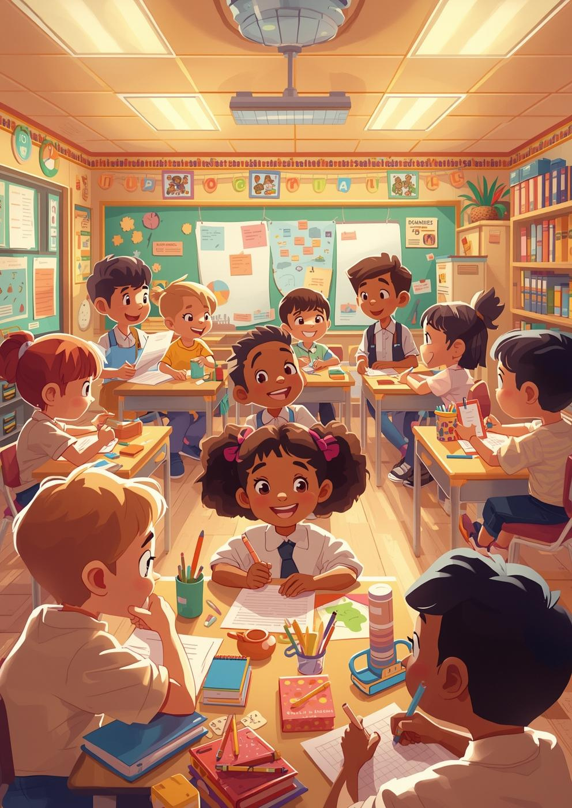
{{judul_slide}}
{{konten}}
2

Slide 3


{{judul_slide}}
{{konten}}
3

Slide 4
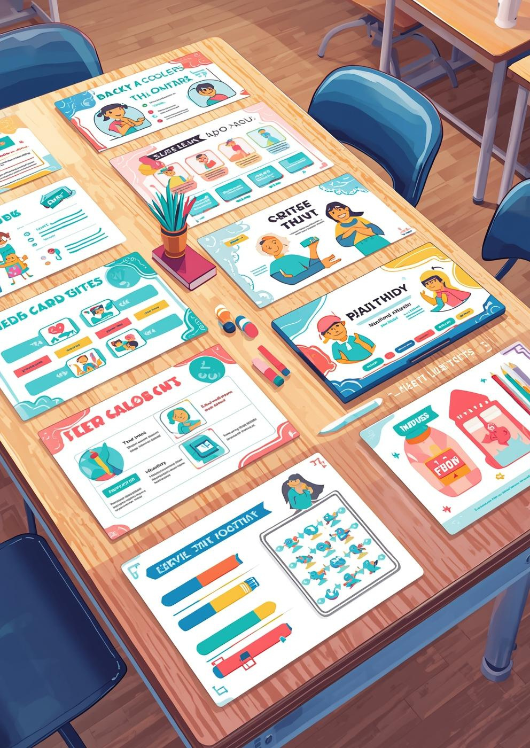
{{judul_slide}}
{{konten}}
4

Slide 5
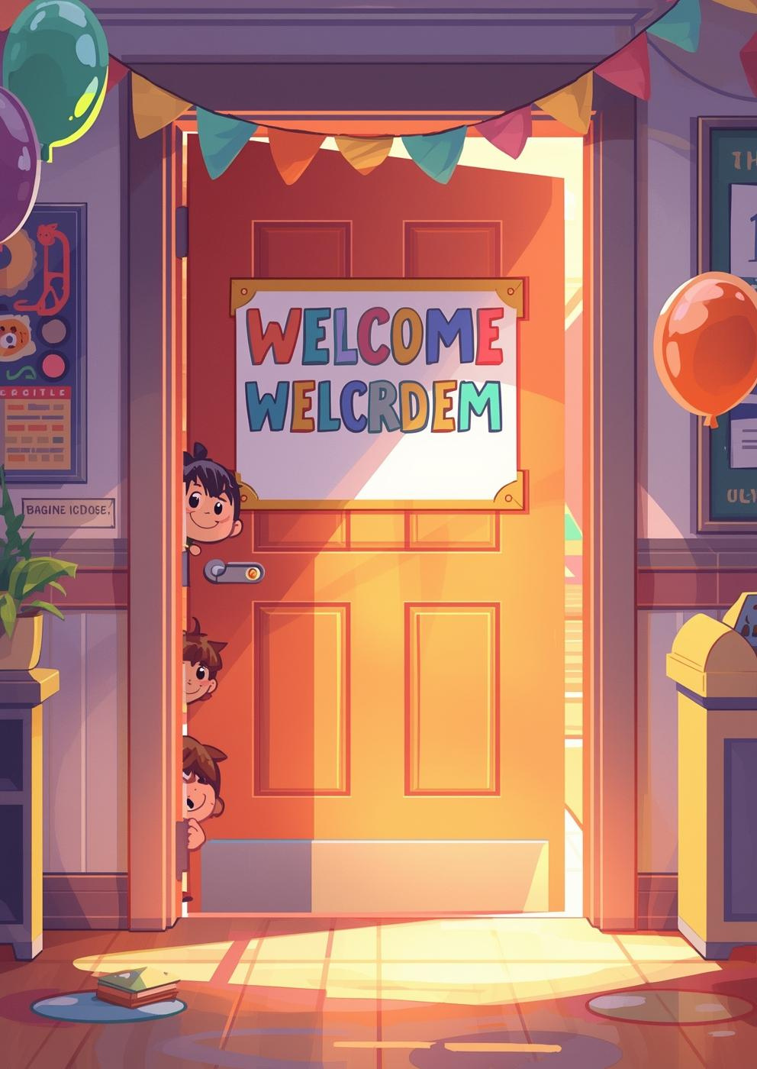
{{judul_slide}}
{{konten}}
5

Slide 6

{{judul_slide}}
{{konten}}
6

Slide 7

{{judul_slide}}
{{konten}}
7

Slide 8

{{judul_slide}}
{{konten}}
8

Slide 9

{{judul_slide}}
{{konten}}
9

Slide 10

{{judul_slide}}
{{konten}}
10

Slide 11

{{judul_slide}}
{{konten}}
11

Slide 12

{{judul_slide}}
{{konten}}
12

Slide 13

{{judul_slide}}
{{konten}}
13

Slide 14

{{judul_slide}}
{{konten}}
14

Slide 15
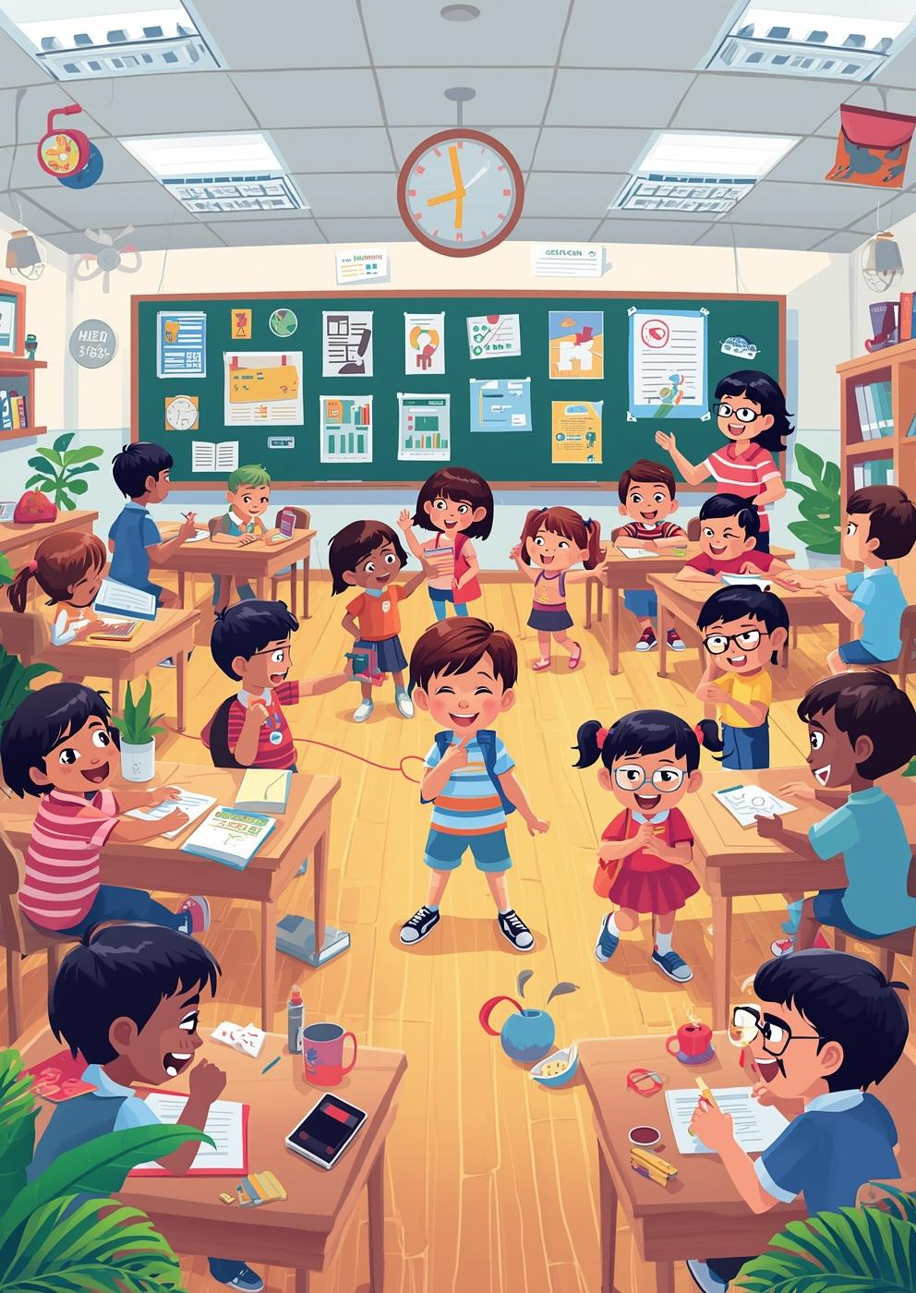
{{judul_slide}}
{{konten}}
15

